Slide 1
Capstone Project – Farmer's Markets
Presentation by: Sara

Slide 2
Farmer's Markets – Introduction
Farmer's markets are a key factor in the health of a population due to greater proximity to quality food sources and greater trust from consumers because they can get to know their local farmers and trust that the food is produced to their standards.
Farmer's markets that sell a greater variety of foods and accept non-cash methods of payment may be likelier to draw more customers and increase their presence in the local areas.

Slide 3
Farmer's Markets – Introduction
With news stories of food recalls due to pathogens such as E. Coli O157:H7 in romaine lettuce¹ or foreign matter such as hard plastic in chicken breasts², farmer's markets can be seen as a source of food produced closer to home, with less risk of contamination.
¹ https://www.cdc.gov/ecoli/2018/o157h7-04-18/index.html
² https://www.fsis.usda.gov/wps/portal/fsis/topics/recalls-and-public-health-alerts/recall-case-archive/archive/2018/recall-026-2018-release

Slide 4
Farmer's Markets – Outline of Approach
Obtain the data from the United States Department of Agriculture (USDA).
Wrangle the data
Statistical and visual analysis
Regression and predictions
Conclusion

Slide 5
Farmer's Markets – Obtain the Data
This dataset was accessed from the United States Department of Agriculture. (https://www.ers.usda.gov/data-products/food-environment-atlas/data-access-and-documentation-downloads/). These are the factors of interest:
FIPSTXT <- Federal Information Processing Standard, the unique identifiers for each county
FMRKTPTH09 <- Farmer's markets per 1,000 people in each county in 2009
FMRKTPTH16 <- Farmer's markets per 1,000 people in each county in 2016
FMRKT_CREDIT16 <- Number of farmer's markets in each county that accepted credit cards in 2016.

Slide 6
Farmer's Markets – Obtain the Data (continued)
FMRKT_SNAP16 <- Farmer's markets in each county that accepted Supplemental Nutrition Assistance Program (SNAP) benefits in 2016.
FMRKT_WIC16 <- Farmer's markets in each county that accepted Women, Infants, and Children (WIC) benefits in 2016.
FMRKT_WICCASH16 <- Number of farmer's markets in each county that accepted WIC Cash Value Vouchers (WICCash) in 2016.
FMRKT_SFMNP16 <- Number of farmer's markets in each county that accepted Senior Farmers' Market Nutrition Program benefits in 2016.

Slide 7
Farmer's Markets – Obtain the Data (continued)
FMRKT_FRVEG16 <- Number of farmer's markets in each county that sold fruits and vegetables in 2016.
FMRKT_ANMLPROD16 <- Number of farmer's markets in each county that sold animal products in 2016.
FMRKT_BAKED16 <- Number of farmer's markets in each county that sold baked goods in 2016.
FMRKT_OTHERFOOD16 <- Number of farmer's markets in each county that sold other food products in 2016.

Slide 8
Farmer's Markets – Obtain the Data (continued)
Limitations
The data does not show which types of markets increased or decreased.
No variables for markets that sell non-food items, have entertainment, or have food truck vendors.
No dollar sales figures, so we cannot see how people spend.
Only two points in time, 2009 and 2016 (with the food and payment types for 2016 only) so we may miss other possible factors such as regulations and month-to-month trends.
Factors that influence changes in markets may vary between states or regions.

Slide 9
Farmer's Markets – Data Wrangling
(1) Remove columns that do not add value to the analysis, such as irrelevant columns and the raw numbers of markets in each county.
(2) Make titles of remaining columns easier to understand.
(3) Convert numbers to percentages rounded to the nearest thousandth for readability and distinguishability.
(4) Add columns to help with analysis:

Slide 10
Farmer's Markets – Data Wrangling (continued)
Types of markets per 1,000 people rounded to the nearest thousandth.
Difference between markets per 1,000 people in 2009 and 2016.
Whether or not farmer's markets Increased their presence in counties between 2009 and 2016. (Boolean with 1 for TRUE; 0 for FALSE.)
Whether or not farmer's markets sell each food and accept each method of payment. (Boolean with 1 for TRUE; 0 for FALSE.)
Whether or not a county was located in a particular state and region
(5) “NA” values replaced with zeroes as they are in the rows with zero markets.
(6) Data was logarithmically transformed and normalized for better comparisons.

Slide 11
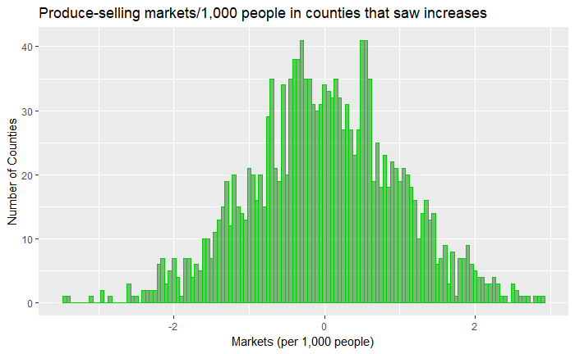
Farmer's Markets – Statistical and Visual Analysis
Normalized number of counties that saw an increase in markets per 1,000 people from 2009 to 2016 that have produce- selling markets.

Slide 12
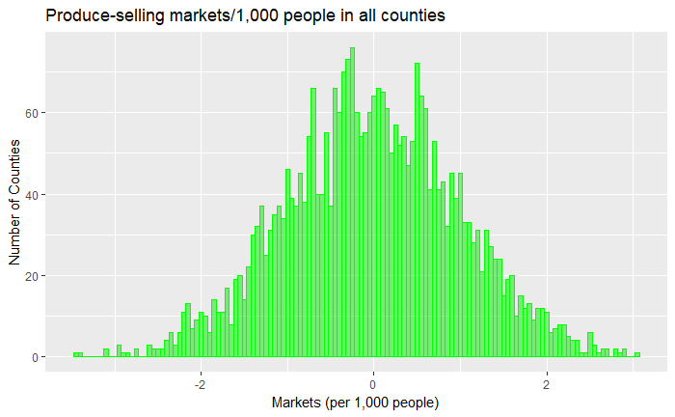
Farmer's Markets – Statistical and Visual Analysis (continued)
Normalized number of counties overall that have produce- selling markets. The mean looks similar to the histogram of the counties that saw an increase in farmer’s markets.

Slide 13
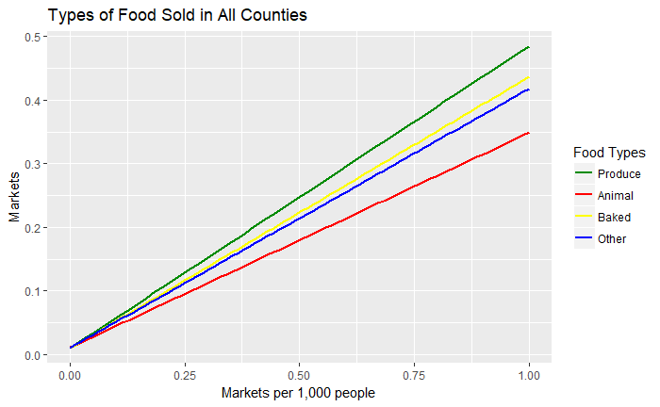
Farmer's Markets – Statistical and Visual Analysis (continued)
It is interesting that the plot for baked goods is closer to the plot for produce. I was thinking that animal products were purchased about as much as produce and that the plot for animal products would closely follow the produce plot. Baked goods are easier to produce and sell than animal products, so it does make sense for the plot of baked goods to more closely follow produce.

Slide 14
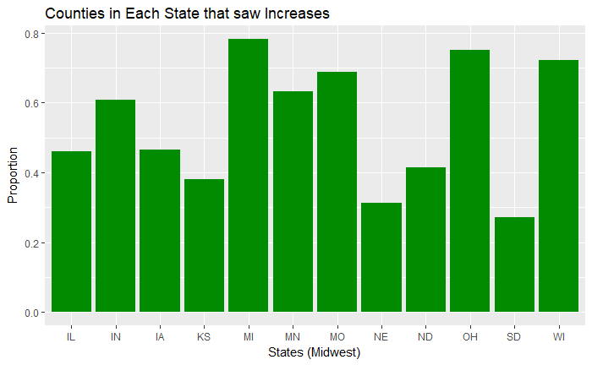
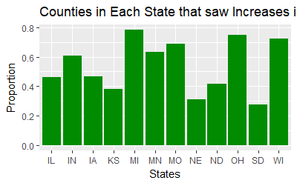
Farmer's Markets – Statistical and Visual Analysis (continued)
The proportion of counties in each state in the Midwest that saw increases in farmer’s markets from 2009 to 2016. There is some variation, with Michigan and Ohio having higher proportions and Nebraska and South Dakota having lower proportions.

Slide 15
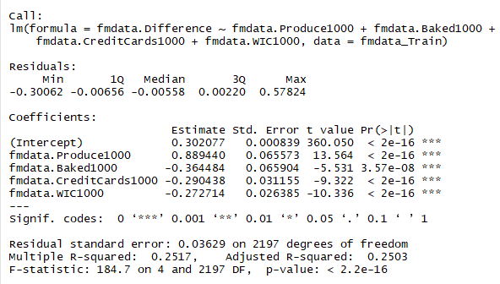
Farmer's Markets – Regression and Predictions
Here is the summary for the linear regression analysis using only the variables that are significant under 0.001. Even with just these variables, the model doesn’t explain the variances well.

Slide 16
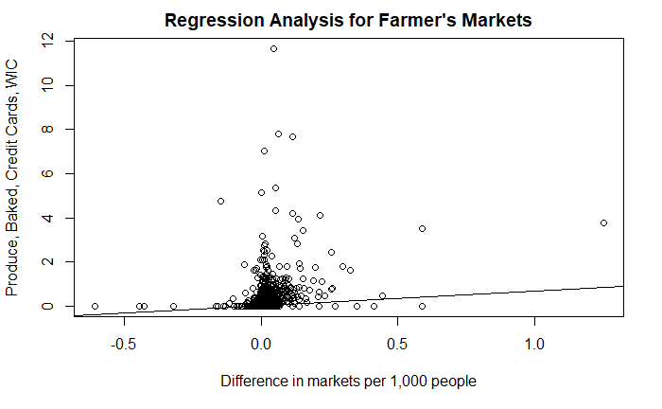
Farmer's Markets – Regression and Predictions (continued)
Here is the linear regression analysis for farmer's markets. There is a large cluster of points around the point “0.0” on the “difference” axis that are far from the regression line. This suggests that the best predictors, Produce1000, Baked1000, WIC1000, and CreditCards1000, are weak predictors for the difference in markets per 1,000 people and visually demonstrates the low percentage of the errors that can be explained by the model.

Slide 17
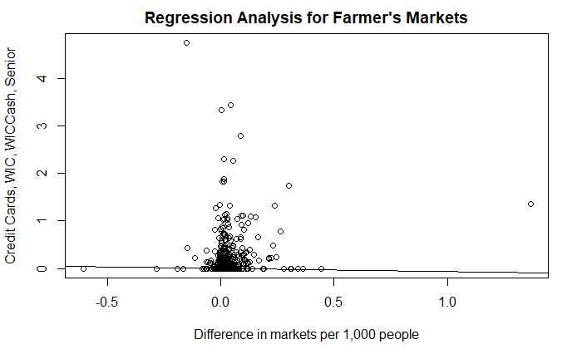
Farmer's Markets – Regression and Predictions (continued)
Here is the linear regression analysis for farmer's markets using the strongest variables. Even using logarithmically normalized data produces a weak model for predicting the difference in markets per 1,000 people and visually demonstrates the low percentage of the errors that can be explained by the model.

Slide 18
Farmer's Markets – Conclusions
There is a fairly weak correlation between the difference in farmer's markets per 1,000 people in 2009 and 2016, and the best predictors given: animal foods, other foods, and credit cards.
Even using all predictors yields a weak model for predicting the difference.
There might be other factors that influence the increase or decrease of farmer's markets, as explained in the limitations of this data set. How people spend at markets, and factors such as non-food items, food trucks, and entertainment may play a bigger role.

Slide 19
Farmer's Markets – Conclusions (continued)
There also could be rules or regulations in some locales that add hurdles to establishing or growing farmer's markets.
Data from just two years in time, 2009 and 2016, may not be enough. The trends could show up better in month-to-month data, more years, or a greater time range, say 20 years, rather than 7.
Changes in markets may vary depending on the region (Northeast, Midwest, South, West), state, or metropolitan/micropolitan area.

Slide 20
Possible Future Analyses
Include food truck vendors, nonfood items, and entertainment.
Analyze data on dollar sales figures of each type of vendor (produce, animal, books, arts and crafts, etc.).
Analyze markets by region, state, or metropolitan/micropolitan area.
Analyze markets month by month.
Analyze markets year by year over a greater period of time.

